Slide 1
Reconstructing Consecration in US Literary History
1965-2000
Dan Sinykin
Emory University
July 2020

Slide 2
The Problem
For the tens of thousands of novels published in the US between 1965 and 2000, the first gate they needed to pass through to achieve consecration was kept by book reviewers. Some novels were never reviewed, others were reviewed extensively, and this has shaped literary history while remaining largely undetected by literary historians, because we have lacked a comprehensive digital record of the book review field.

Slide 3
The Data
Richard Jean So and I scanned and OCR’d the Book Review Index for the years 1965 through 2000 to gain access to a comprehensive list of each instance when a title was reviewed in one of three hundred and ten venues.

Slide 4

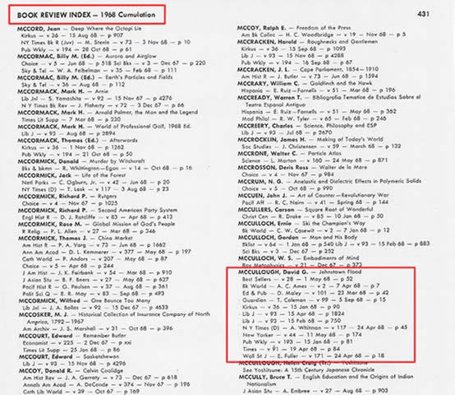
The Data
In hard copy, it looks like this:

Slide 5
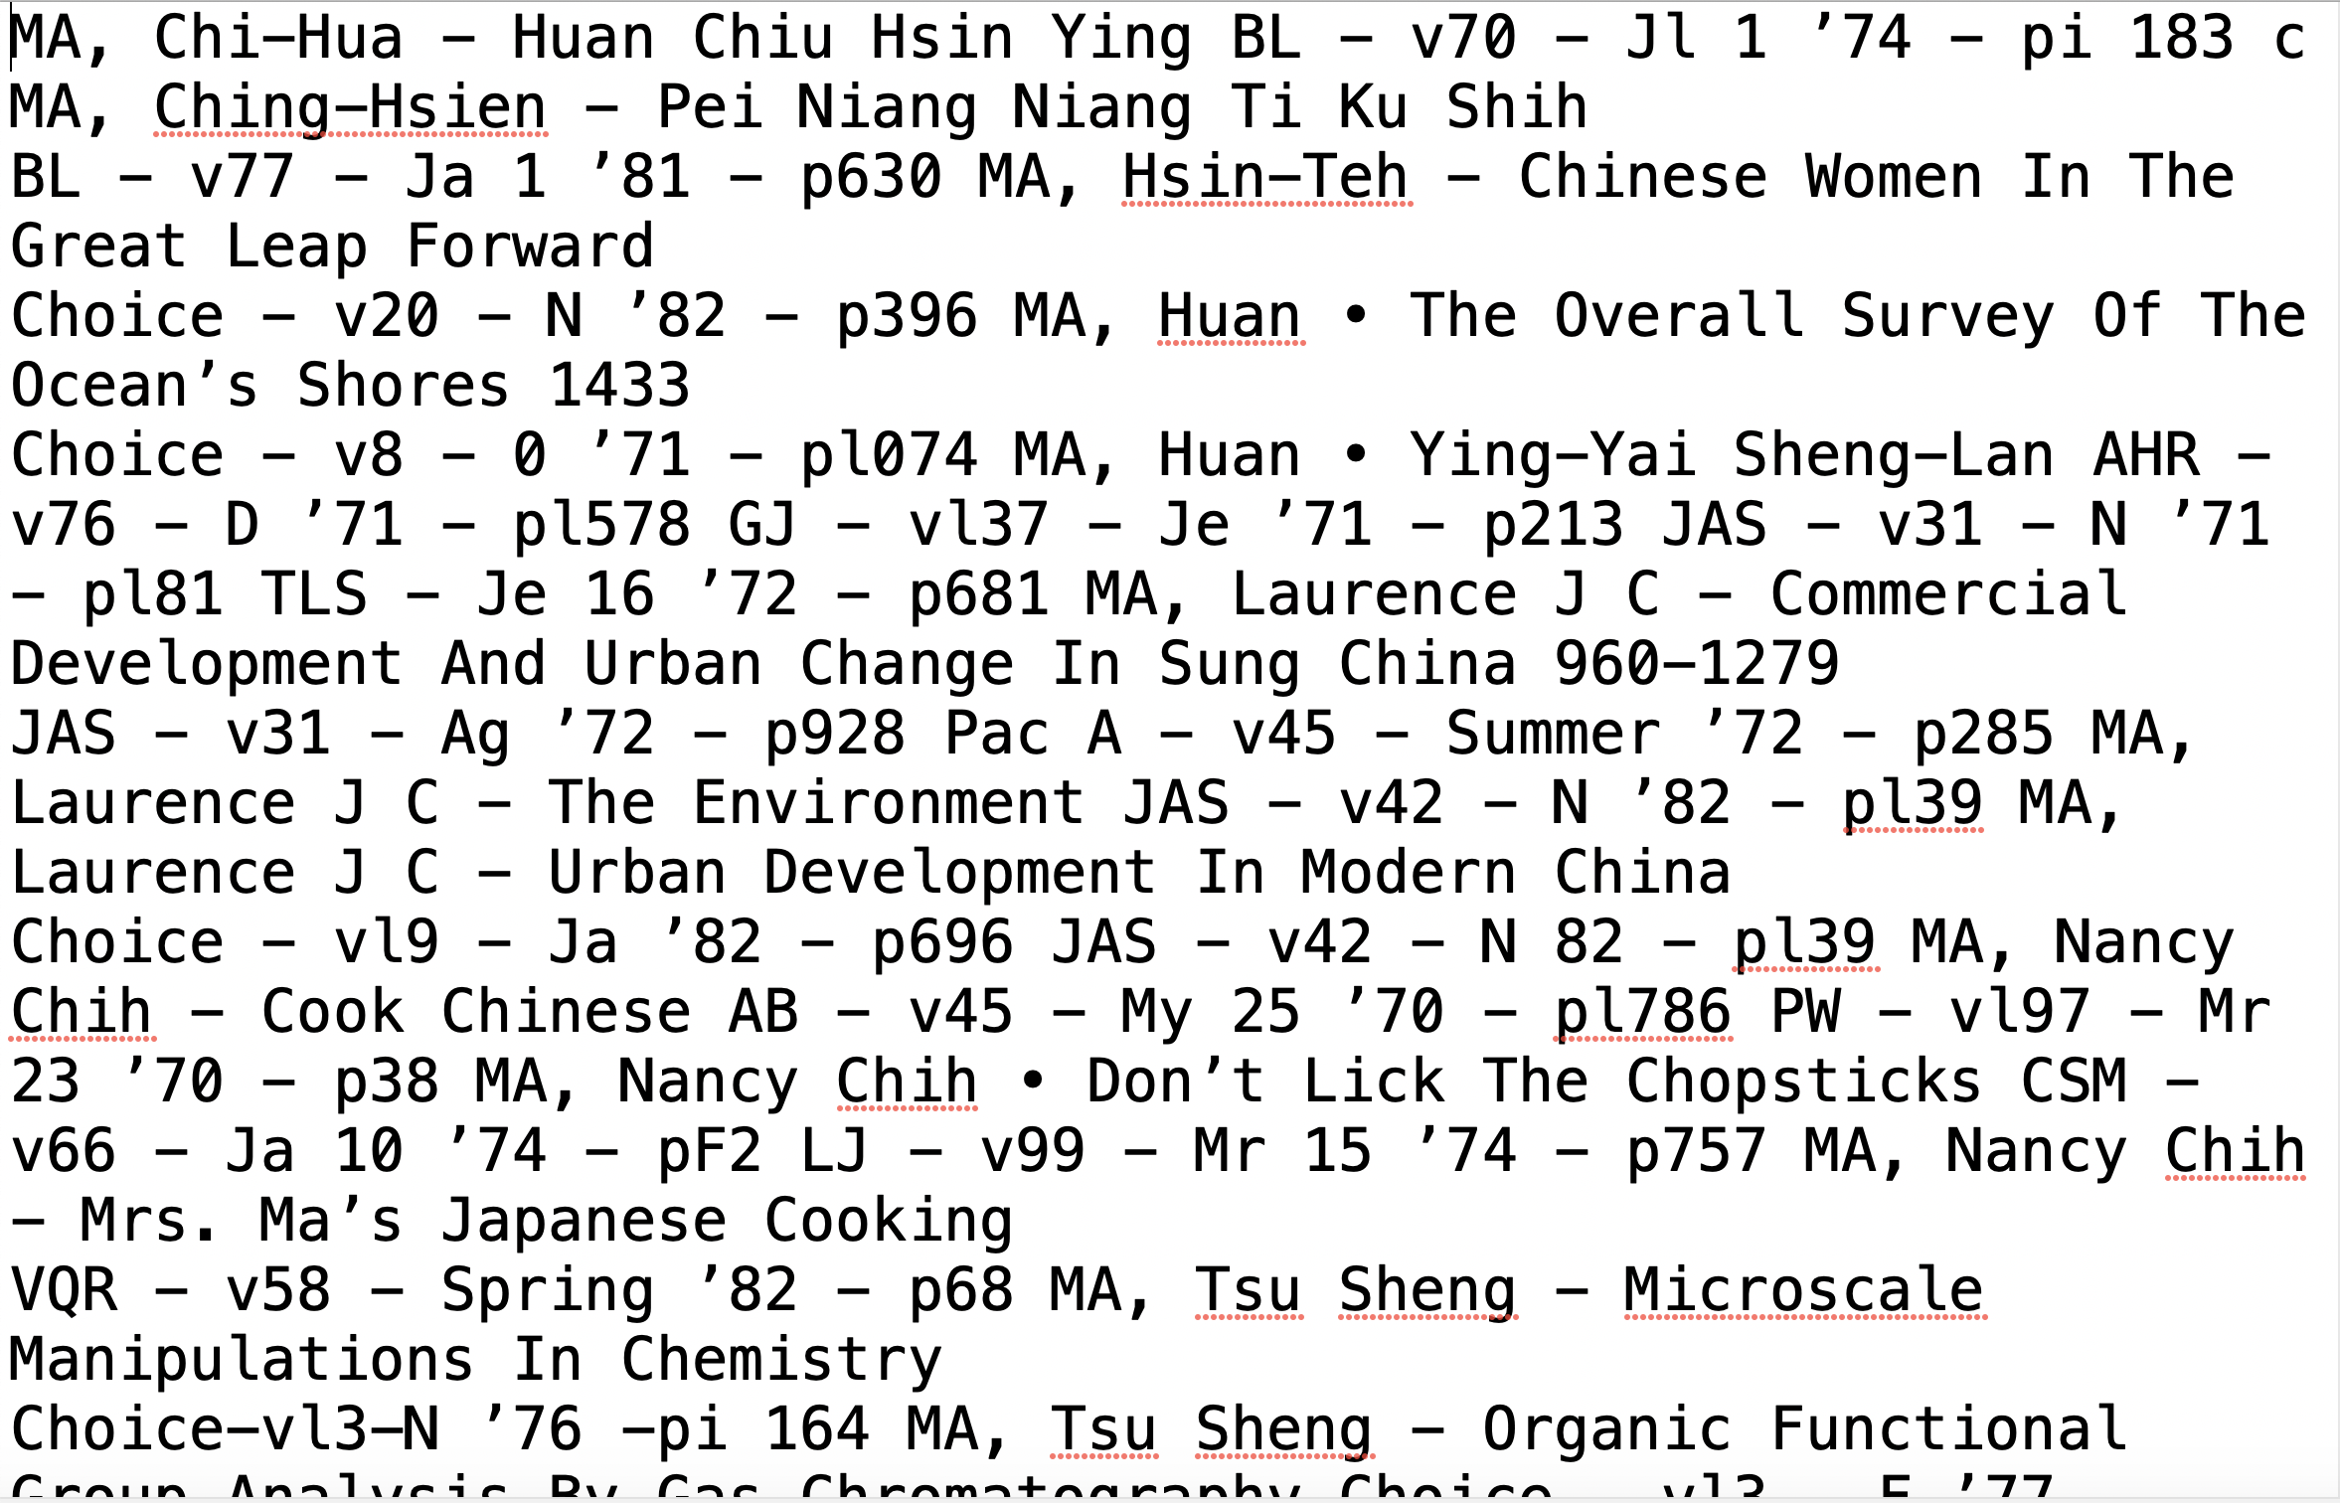
The Data And as an OCR’d .txt file, it looked like…yikes:

Slide 6
The Data
To make the data computationally tractable, we hired a regex wizard. We ended up with just over one million titles and the sites where each was reviewed.

Slide 7
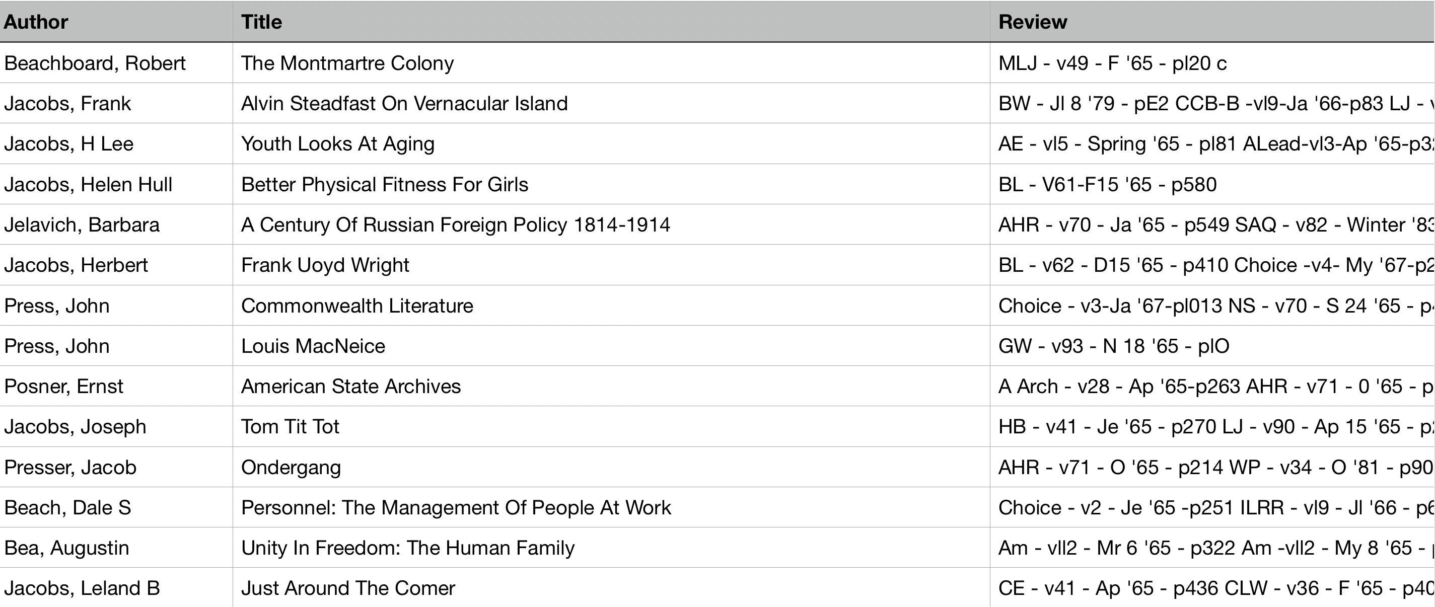
The Data
Cleaned up, it looked like this:

Slide 8
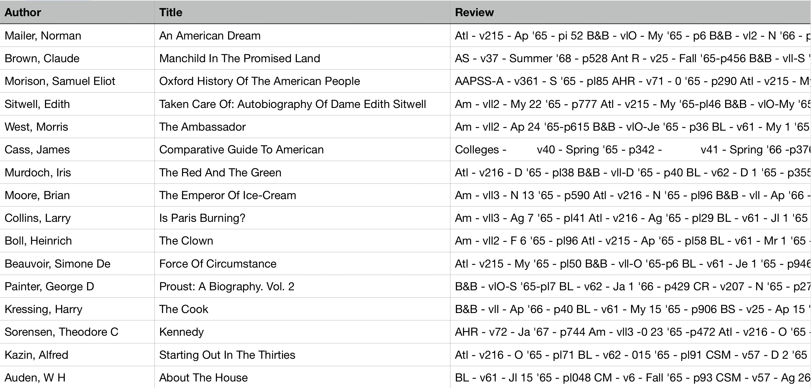
The Data
But this data included all books. And it was huge, a million titles. To make it small enough to supplement with metadata, we selected just the top 1% of titles. Here’s 1965:

Slide 9
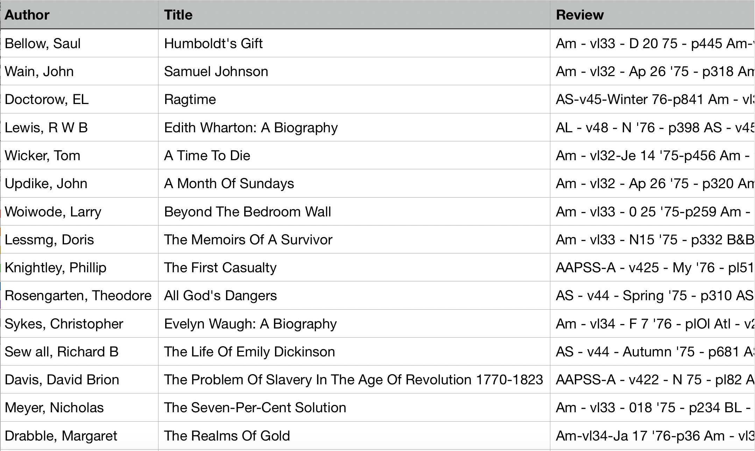
The Data
And 1975

Slide 10
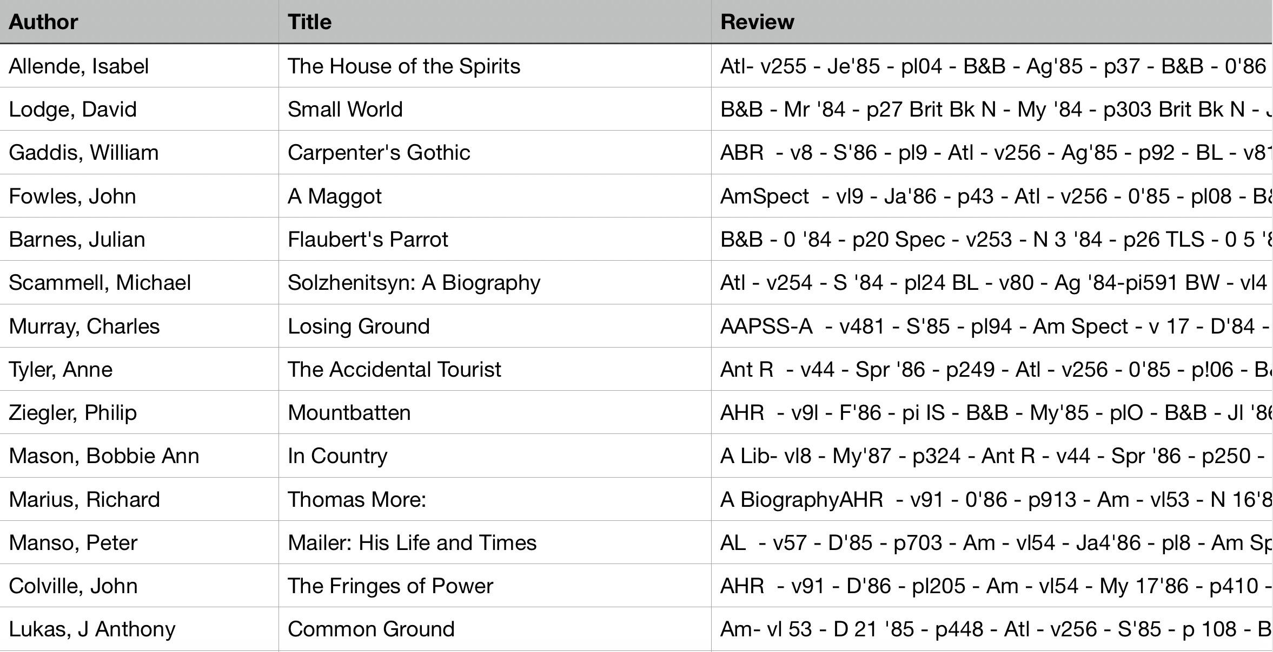
The Data
And 1985:

Slide 11
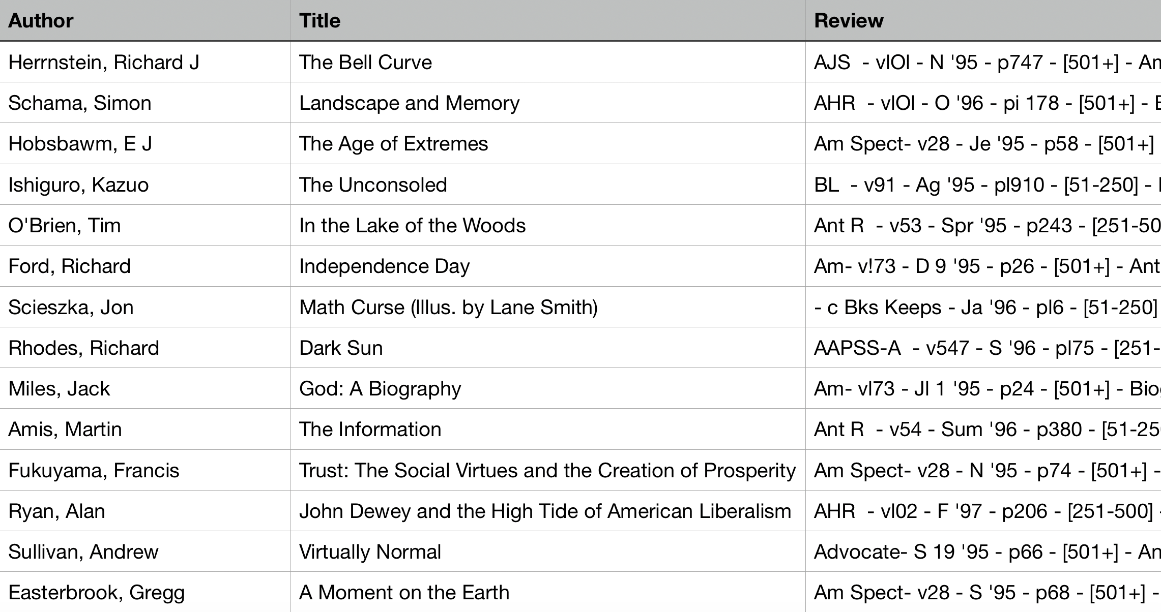
The Data
And 1995:

Slide 12
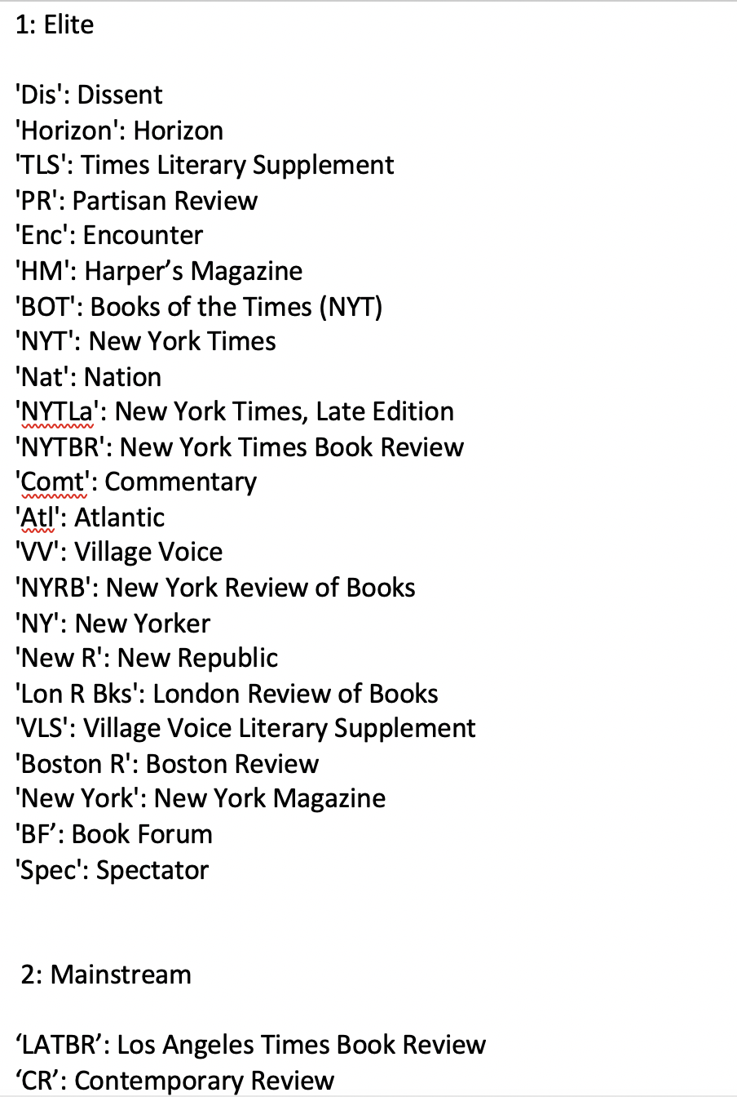
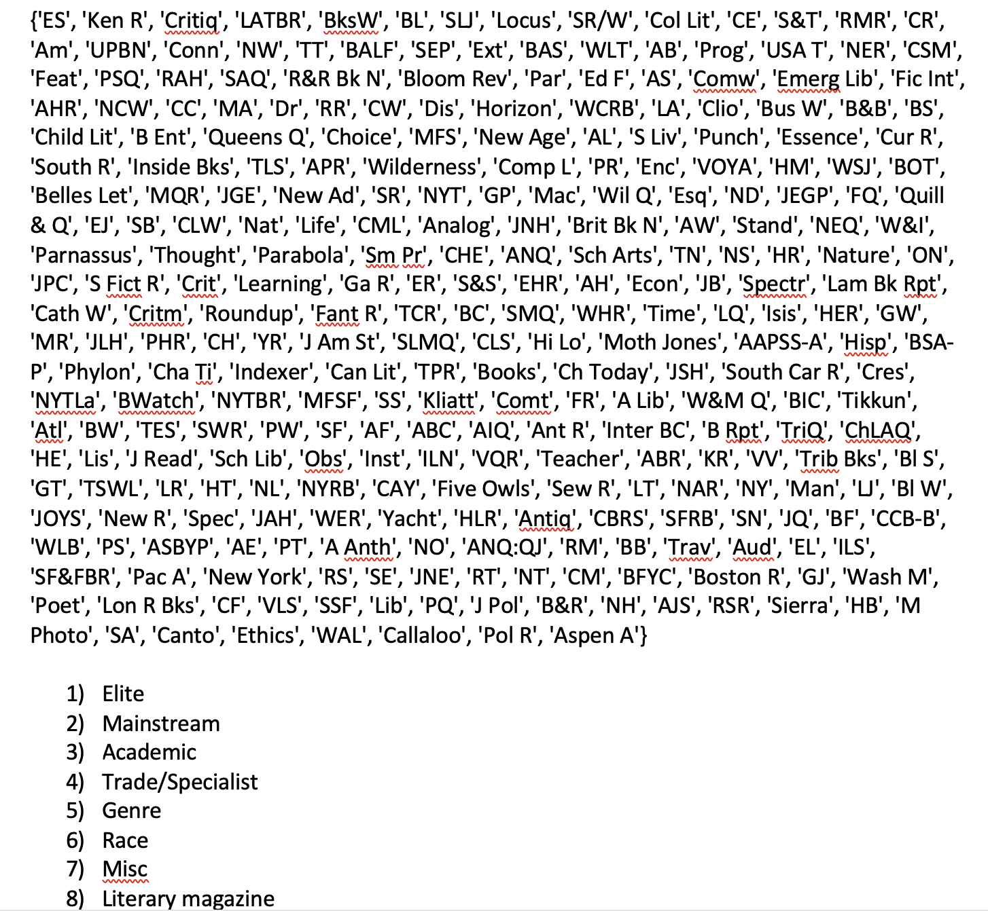
The Metadata
To draw more information from the data, I divided the 310 venues into eight categories:

Slide 13
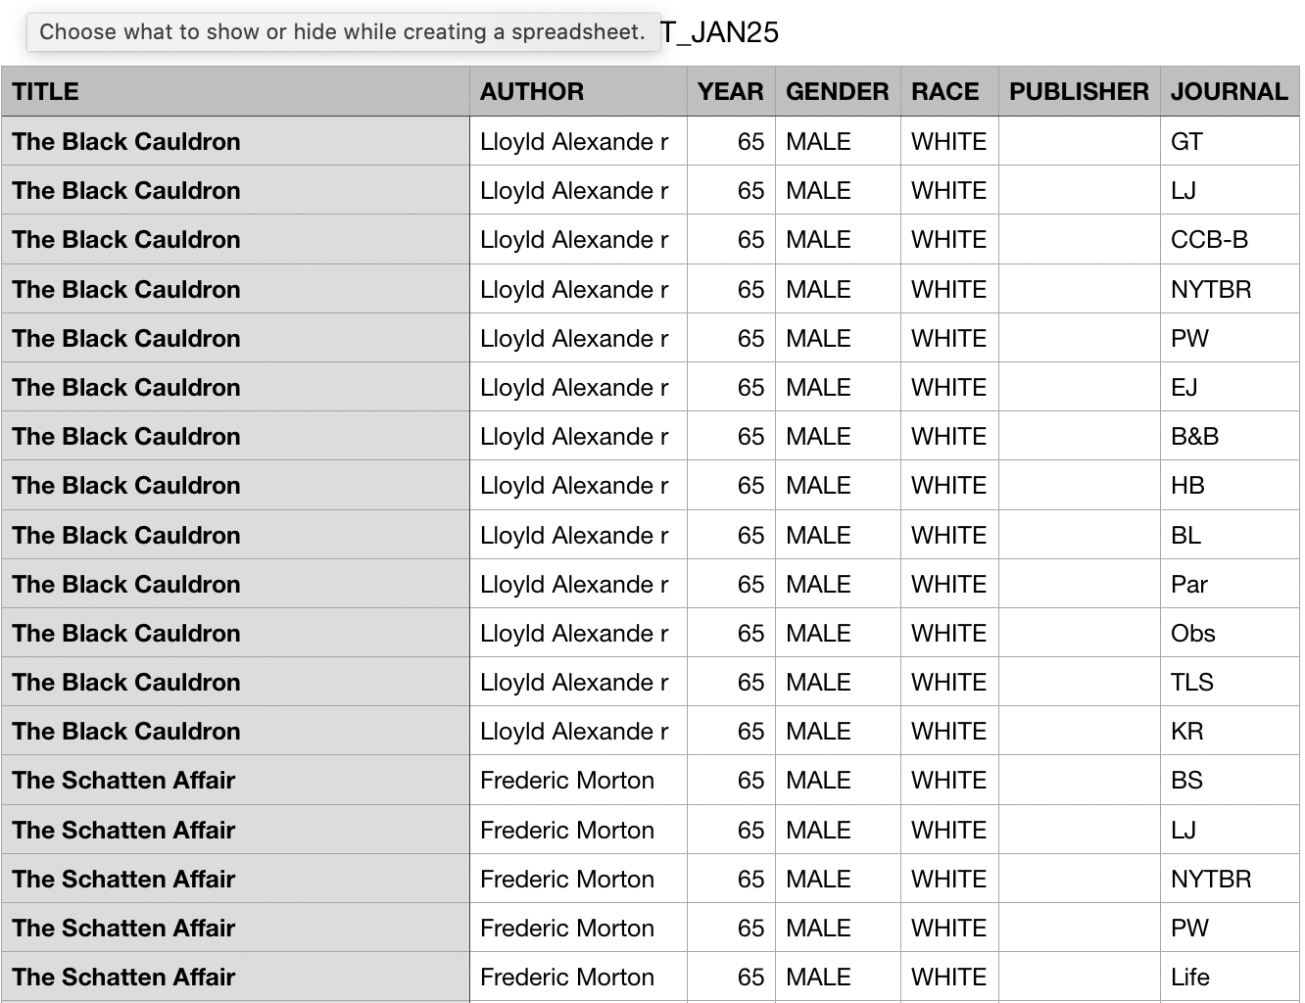
The Metadata
Richard and I, with student support, added the race and gender of the authors:

Slide 14
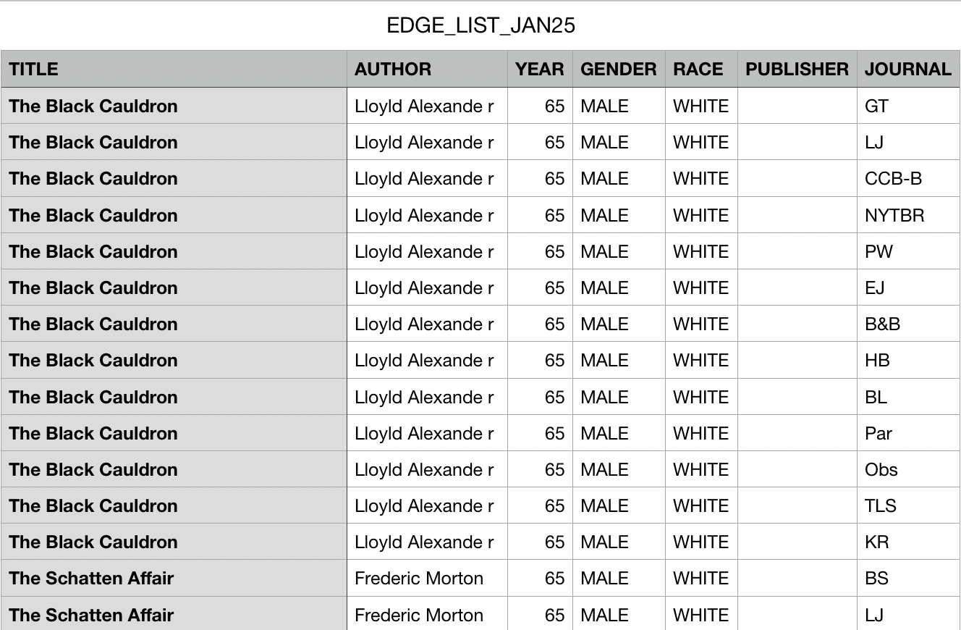
Analytics
Finally, we were ready to produce analytics. I spent some time using social network analysis to study the data. I don’t think this is the best method. But with an edge list, I was able to learn something.

Slide 15

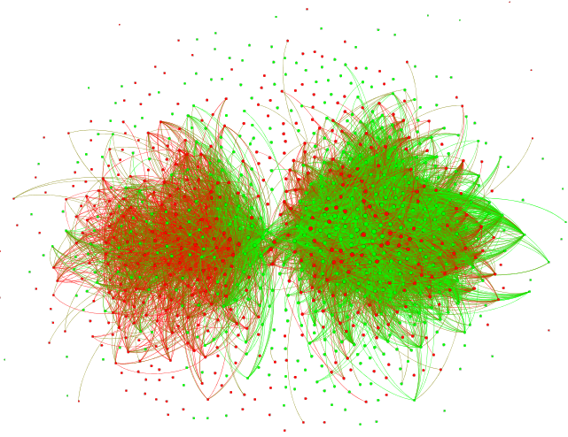
Analytics
These are old social network analysis graphs, now, but they show that toward the end of the 20th century, children’s books split off from other fiction into their own review network, and the two are very gendered
Most-Reviewed Fiction, 1965-1975
Most-Reviewed Fiction, 1990-2000
Green: male-authored texts
Red: female-authored texts

Slide 16
Analytics
Richard and I selected the novels from the set of the 1% most-reviewed titles and ended up with 1776. These we tagged with race, gender, and publisher. I was thus able to determine that if one wanted to enter 1%, one’s best chance was to publish with Random House, which included Knopf, though Farrar Straus & Giroux punched above its weight

Slide 17
Discussion
How else might we put this data to use?
How might we leverage this rich data to better understand the recent history of consecration?

